Slide 1

Solar cell materials:
simulation, optical and photoelectric characterization
Prof. Oleg OLIKH
General Physics Department, Faculty of Physics, Taras Shevchenko National University of Kyiv
Prof. Serhiy KONDRATENKO
Department of Optics, Faculty of Physics, Taras Shevchenko National University of Kyiv

Slide 2

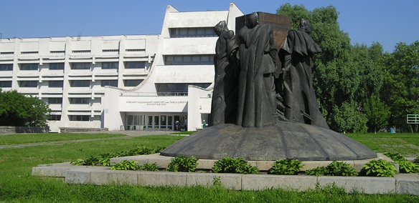


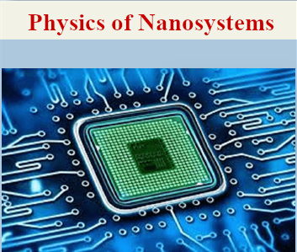
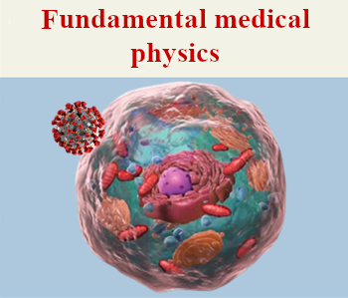
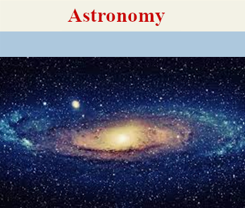
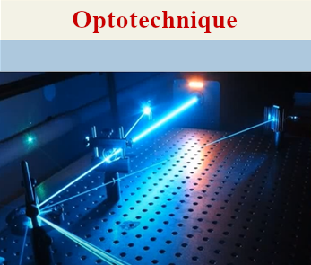
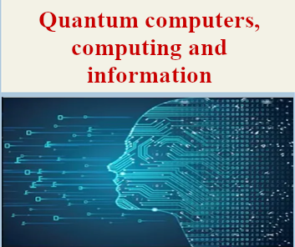
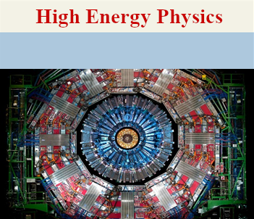
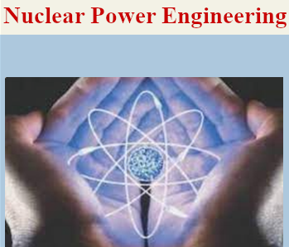
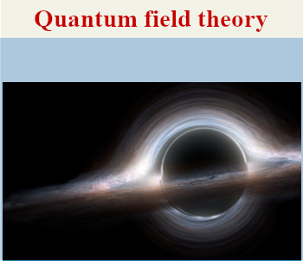
500 students
80 lecturers
140 researchers

Slide 3
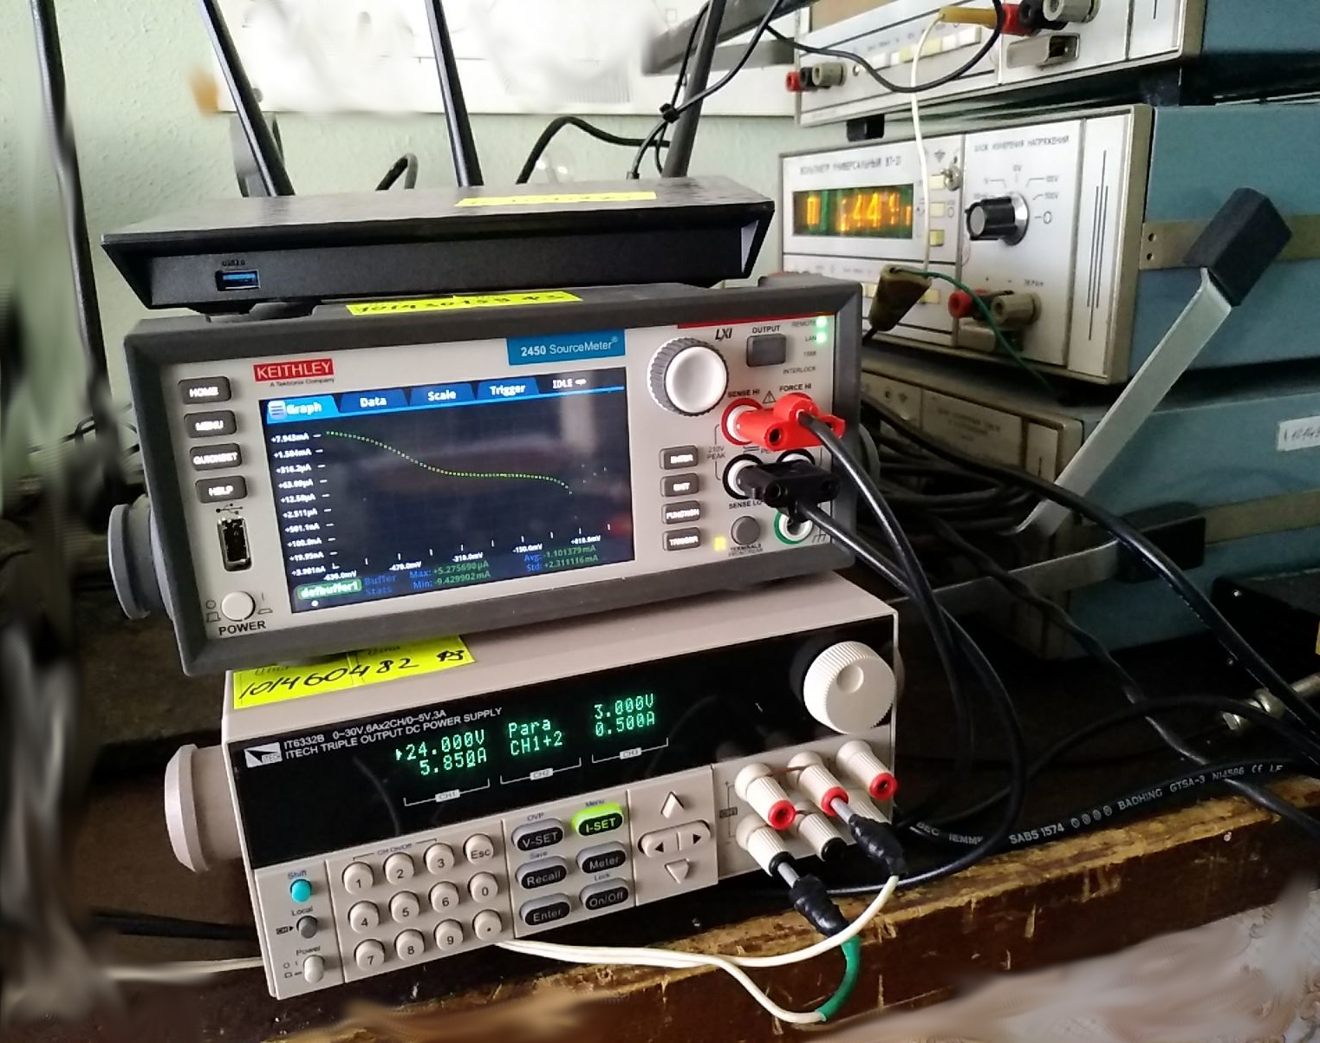
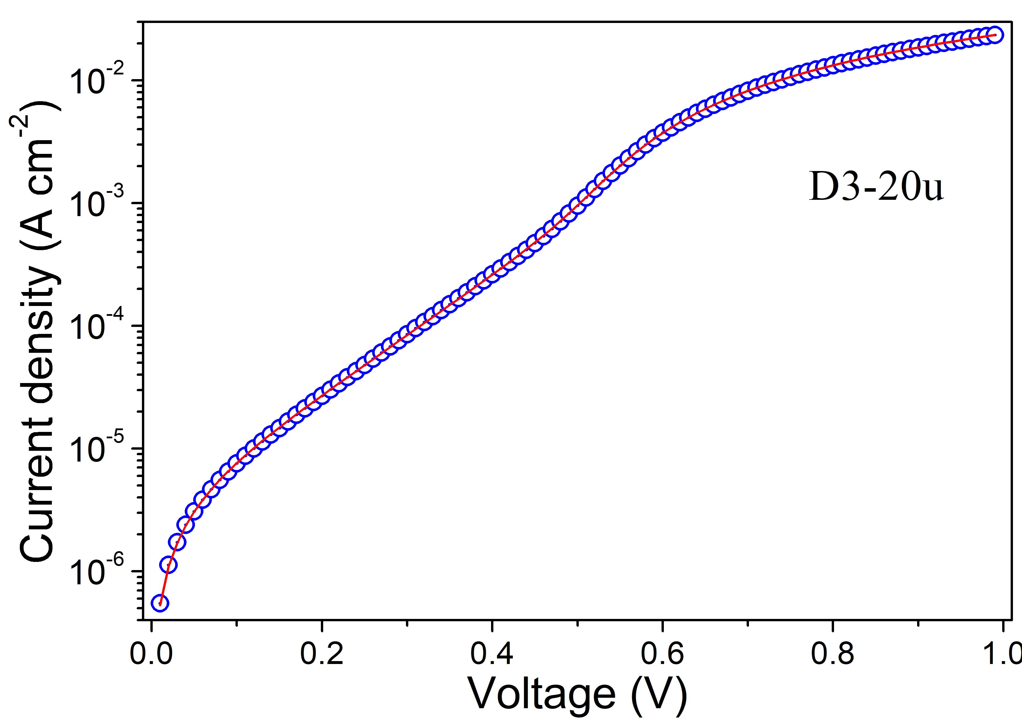
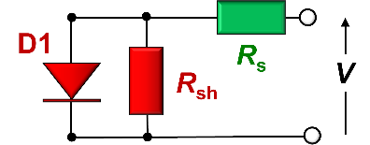
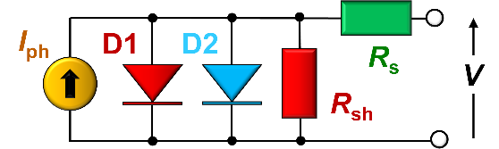
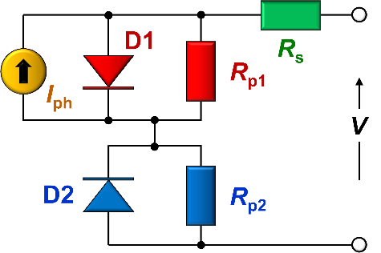
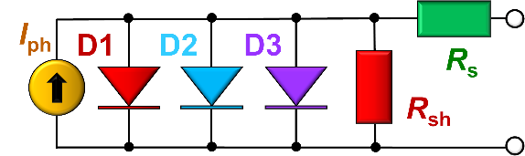
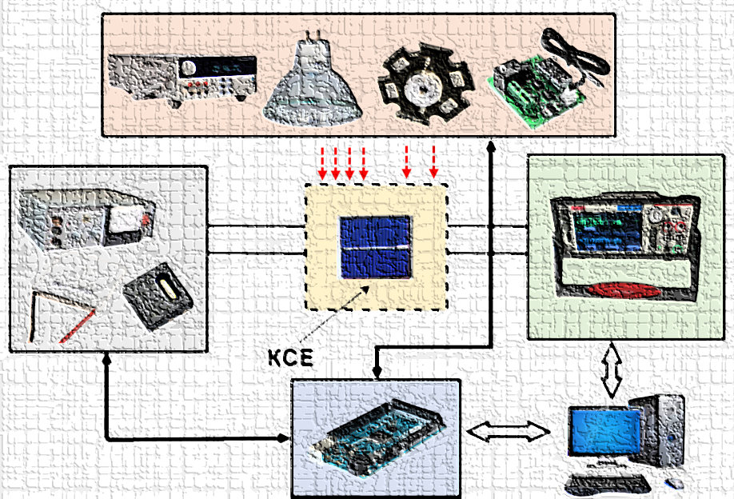
1. Experimental investigations of semiconductor structures for thermoelectrics and solar cells
Current-voltage measurement of solar cells (20 mV – 200 V, 10 nA – 1 A, 150 – 350 K)
under AM1.5 irradiation

Slide 4
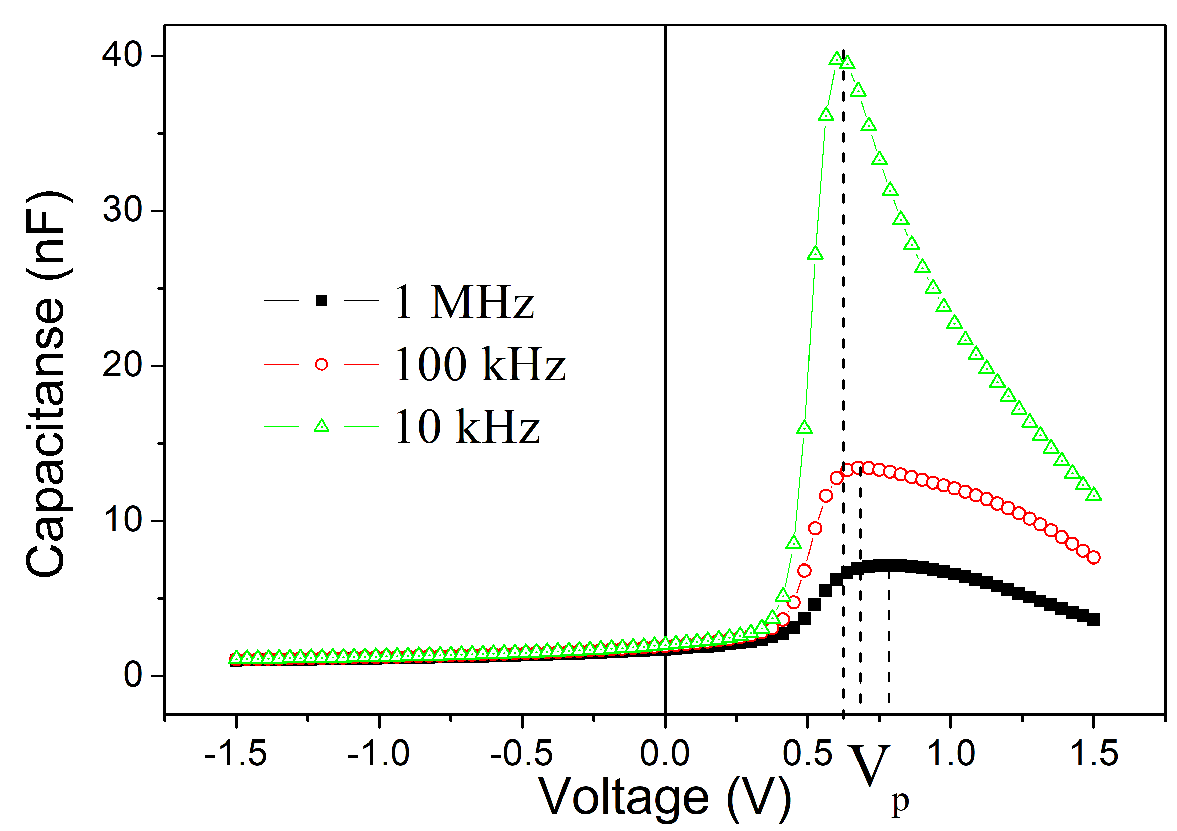
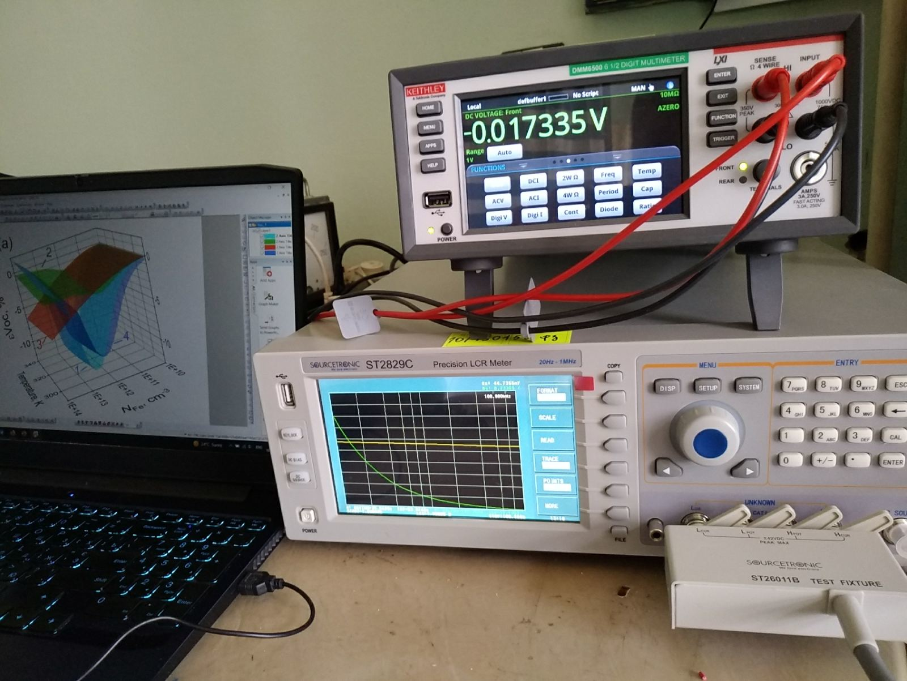
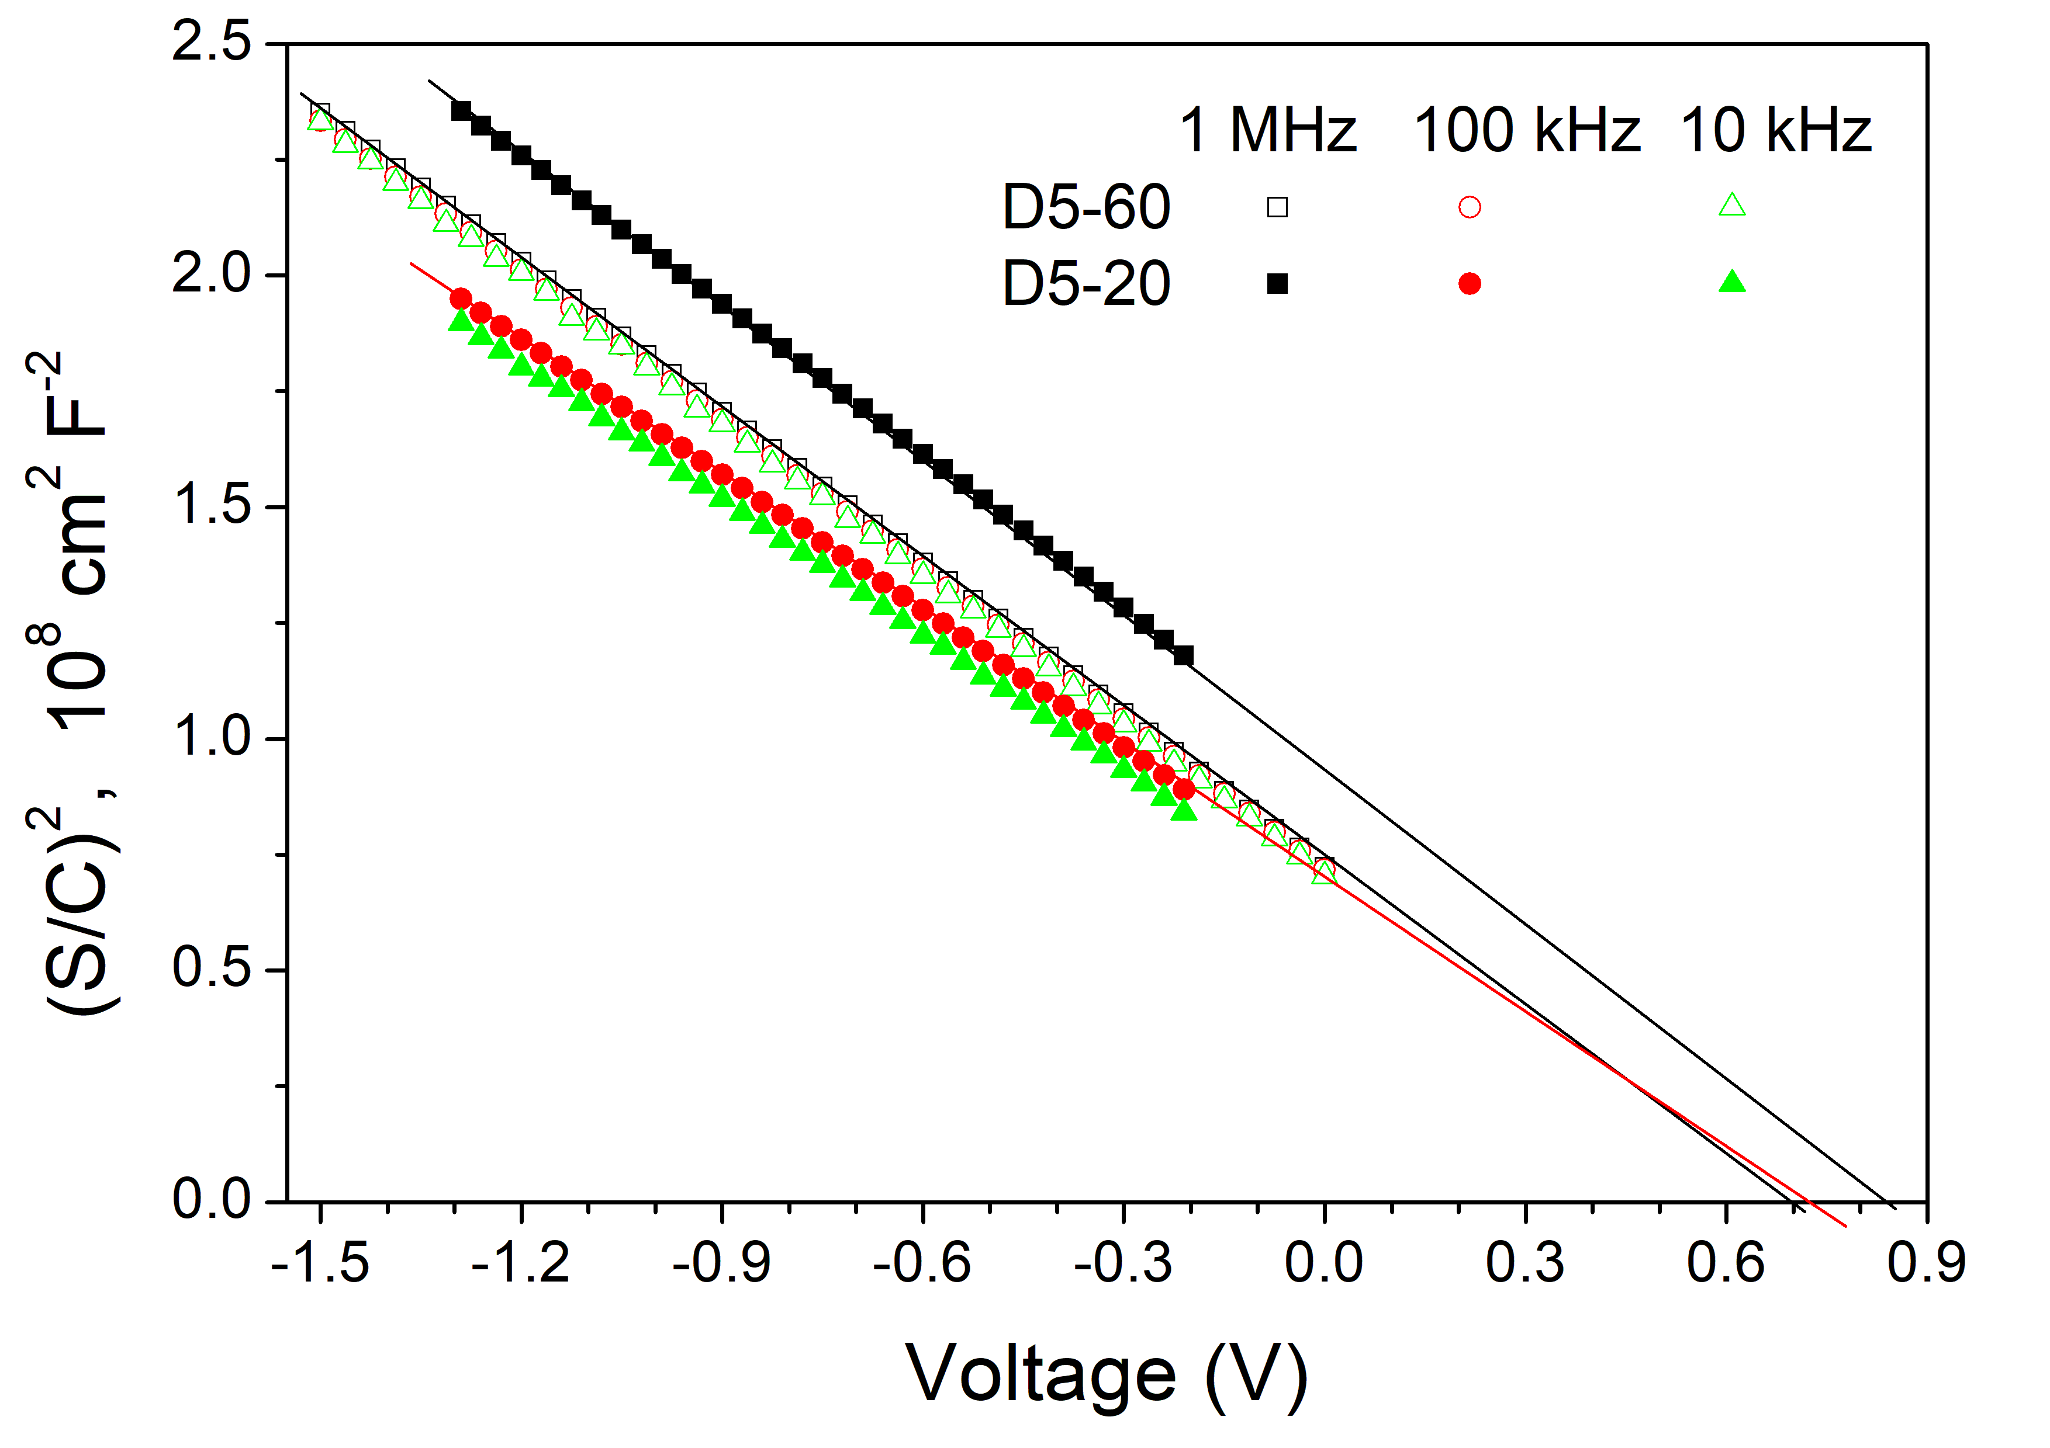
1. Experimental investigations of semiconductor structures for thermoelectrics and solar cells
Capacitance-voltage measurements of semiconductor barrier structures (20 Hz – 1MHz, 1fF – 10 F, 5mV – 10 V)

Slide 5
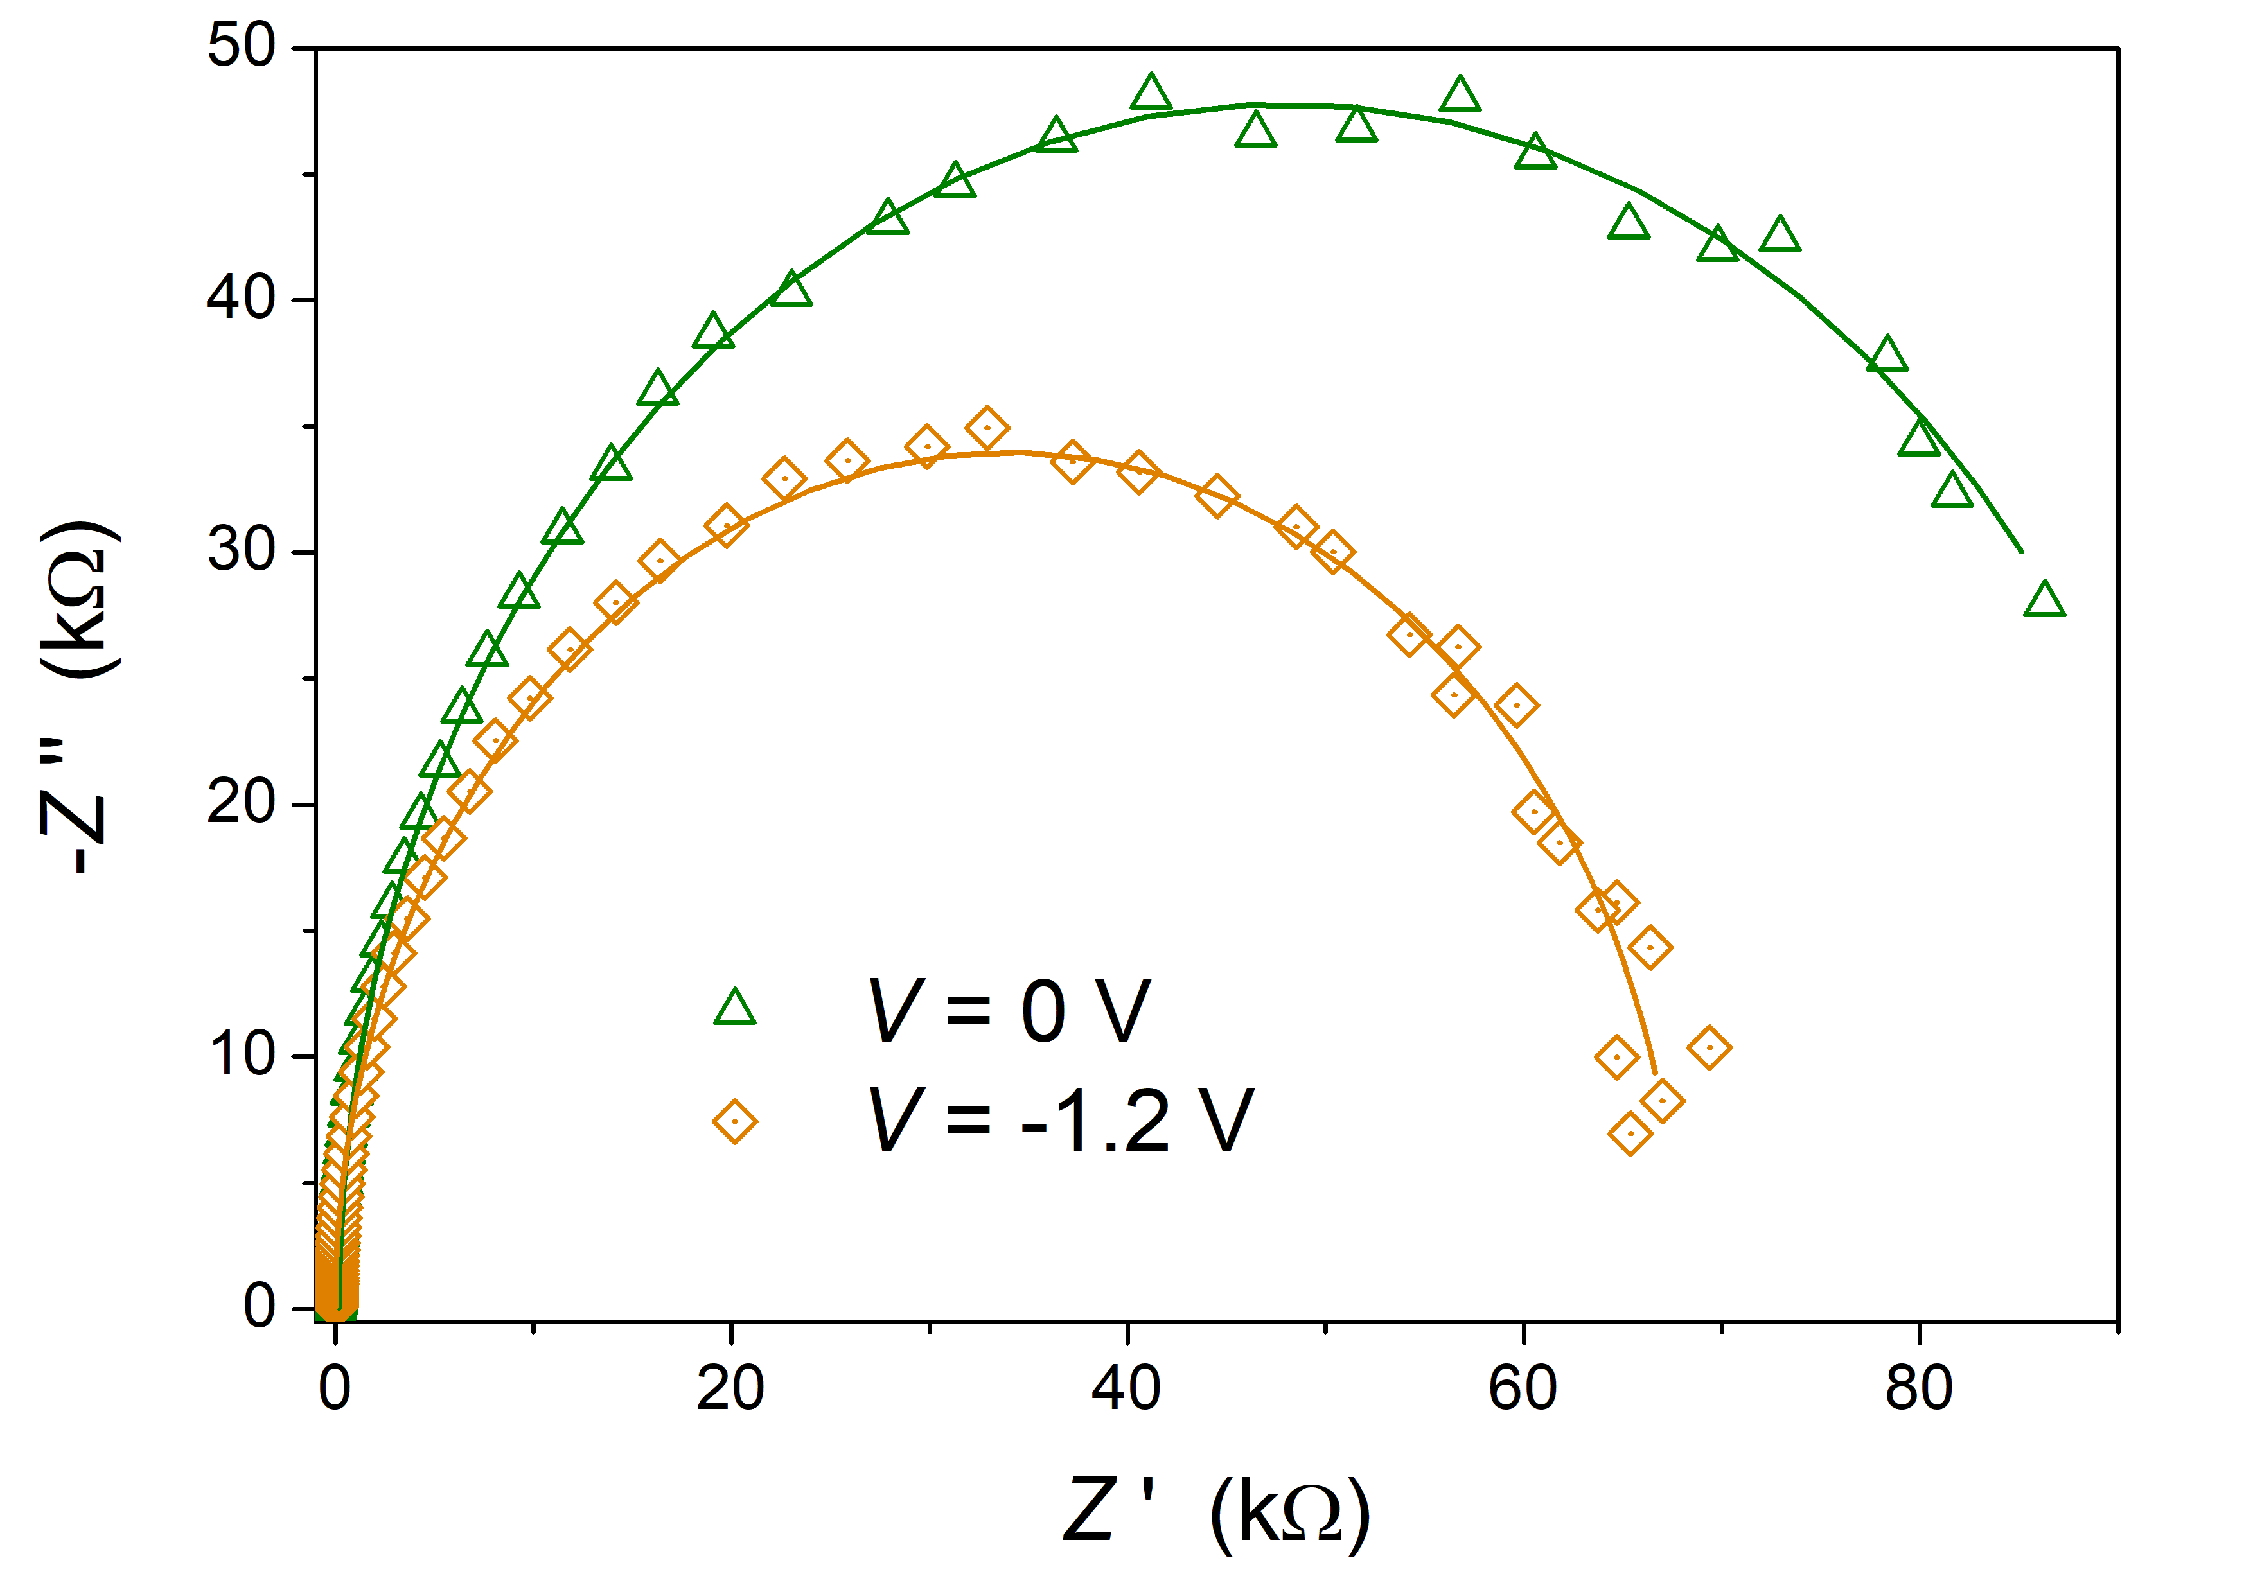
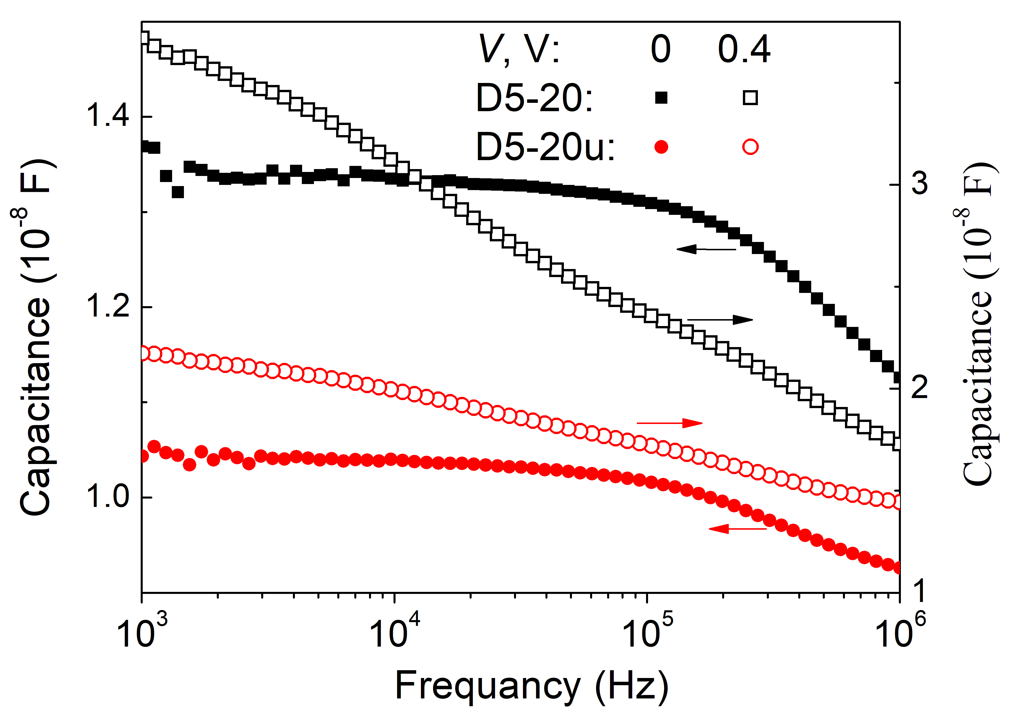
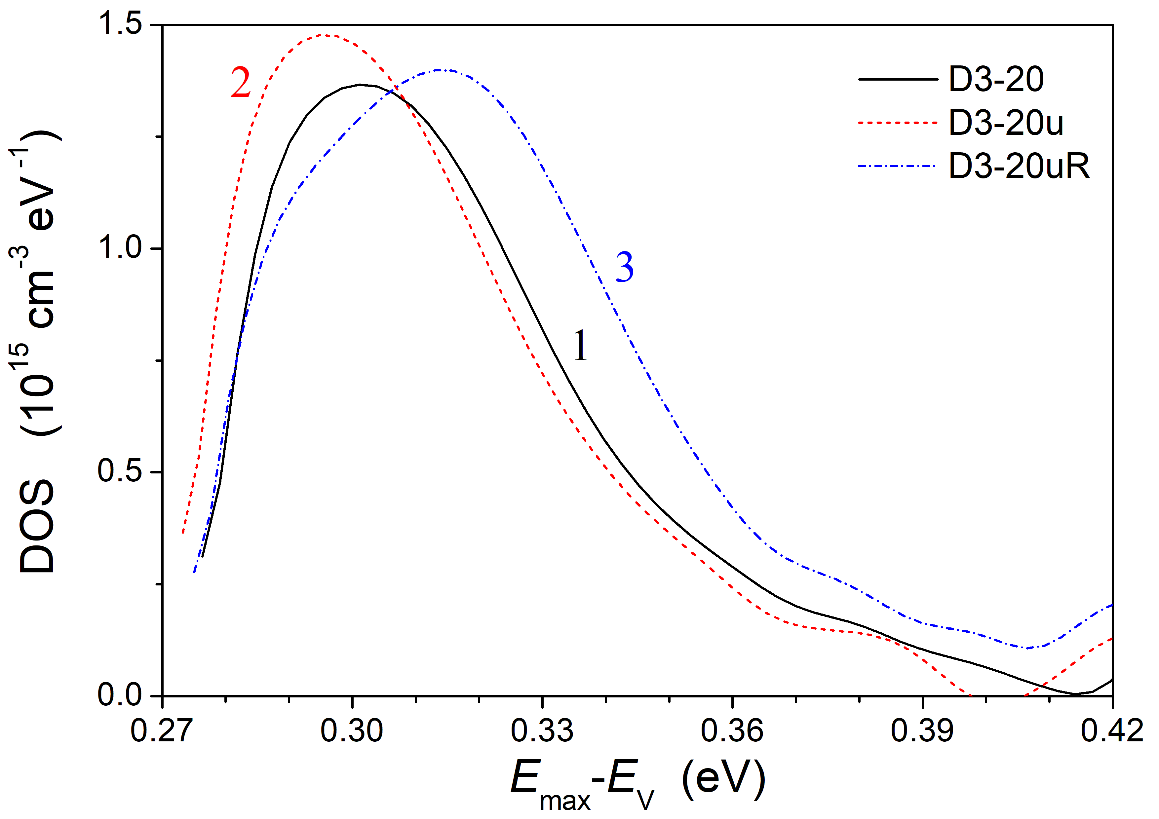
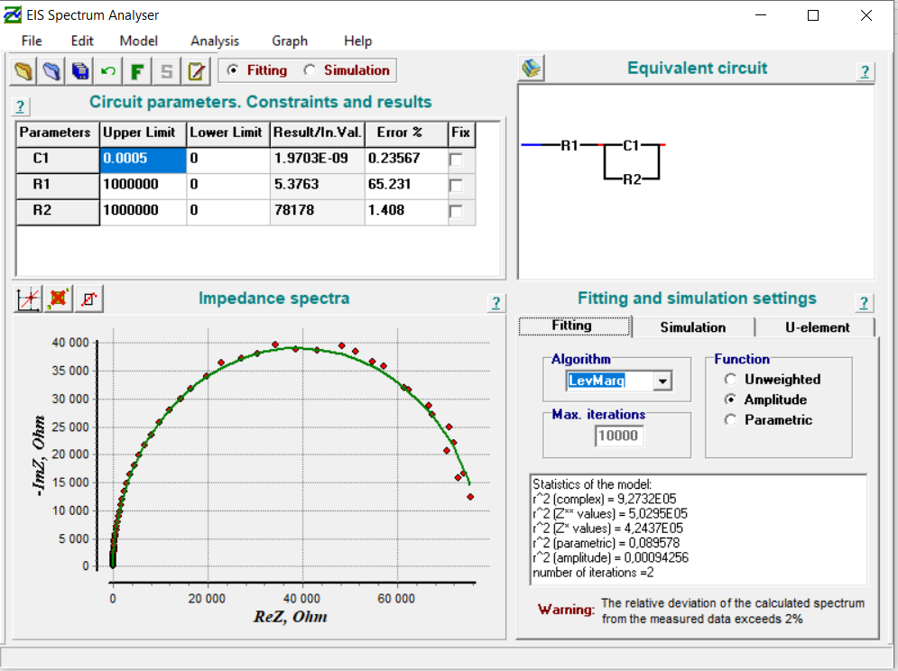
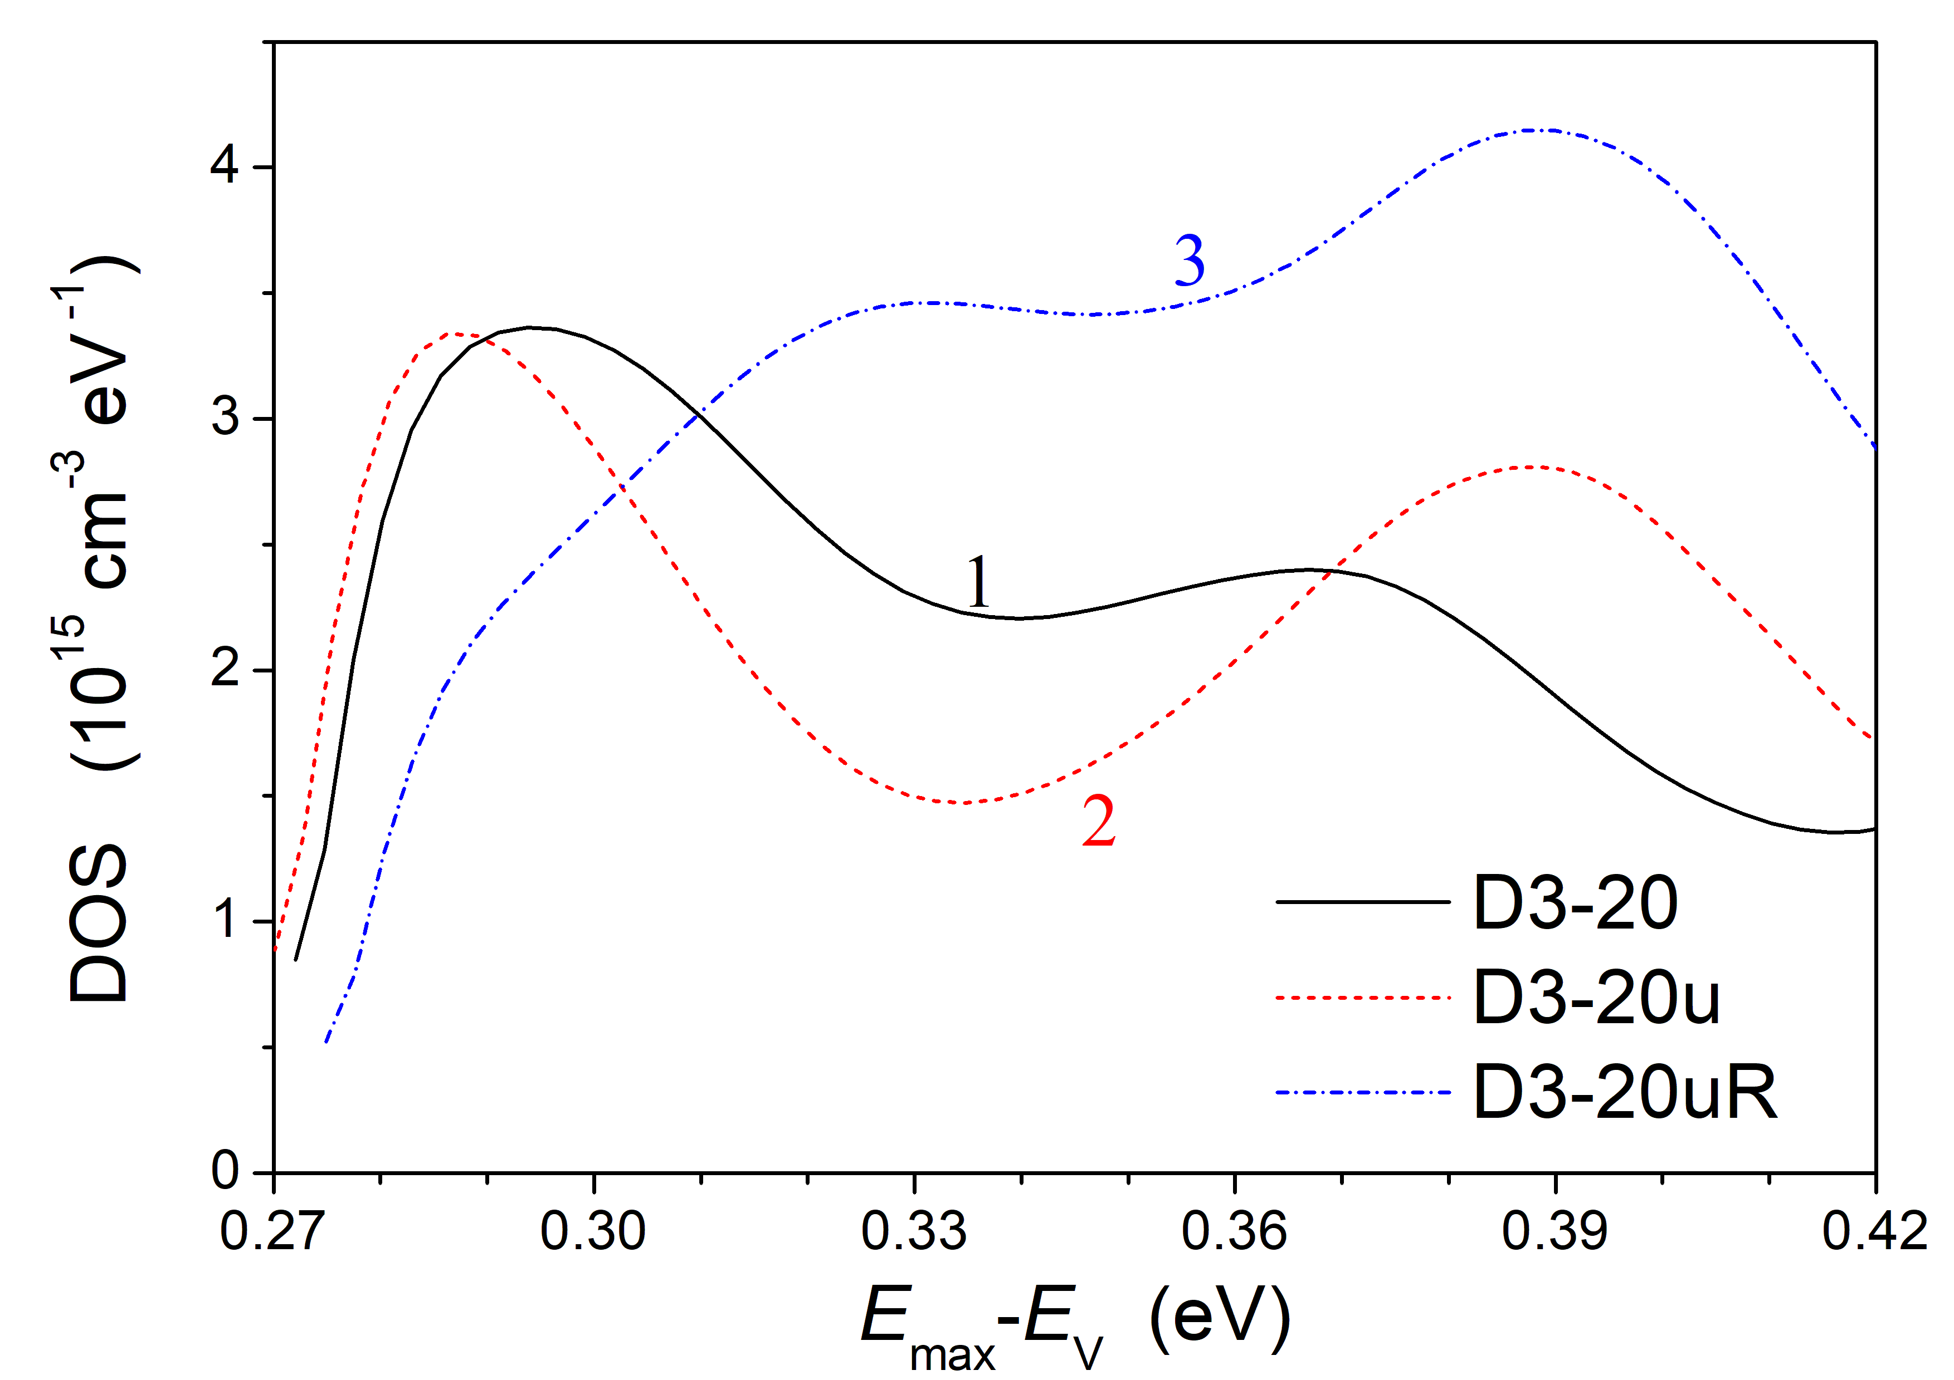
1. Experimental investigations of semiconductor structures for thermoelectrics and solar cells
Impedance and Capacitance Spectroscopies

Slide 6
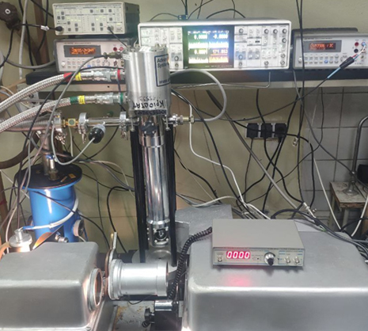
1. Experimental investigations of semiconductor structures for thermoelectrics and solar cells
Photoluminescence, photoconductivity and photovoltage spectroscopies (10-400 K, 0.25-10 μm, pA low current sesitivity)

Slide 7
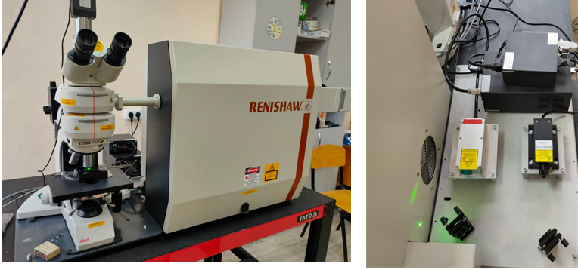
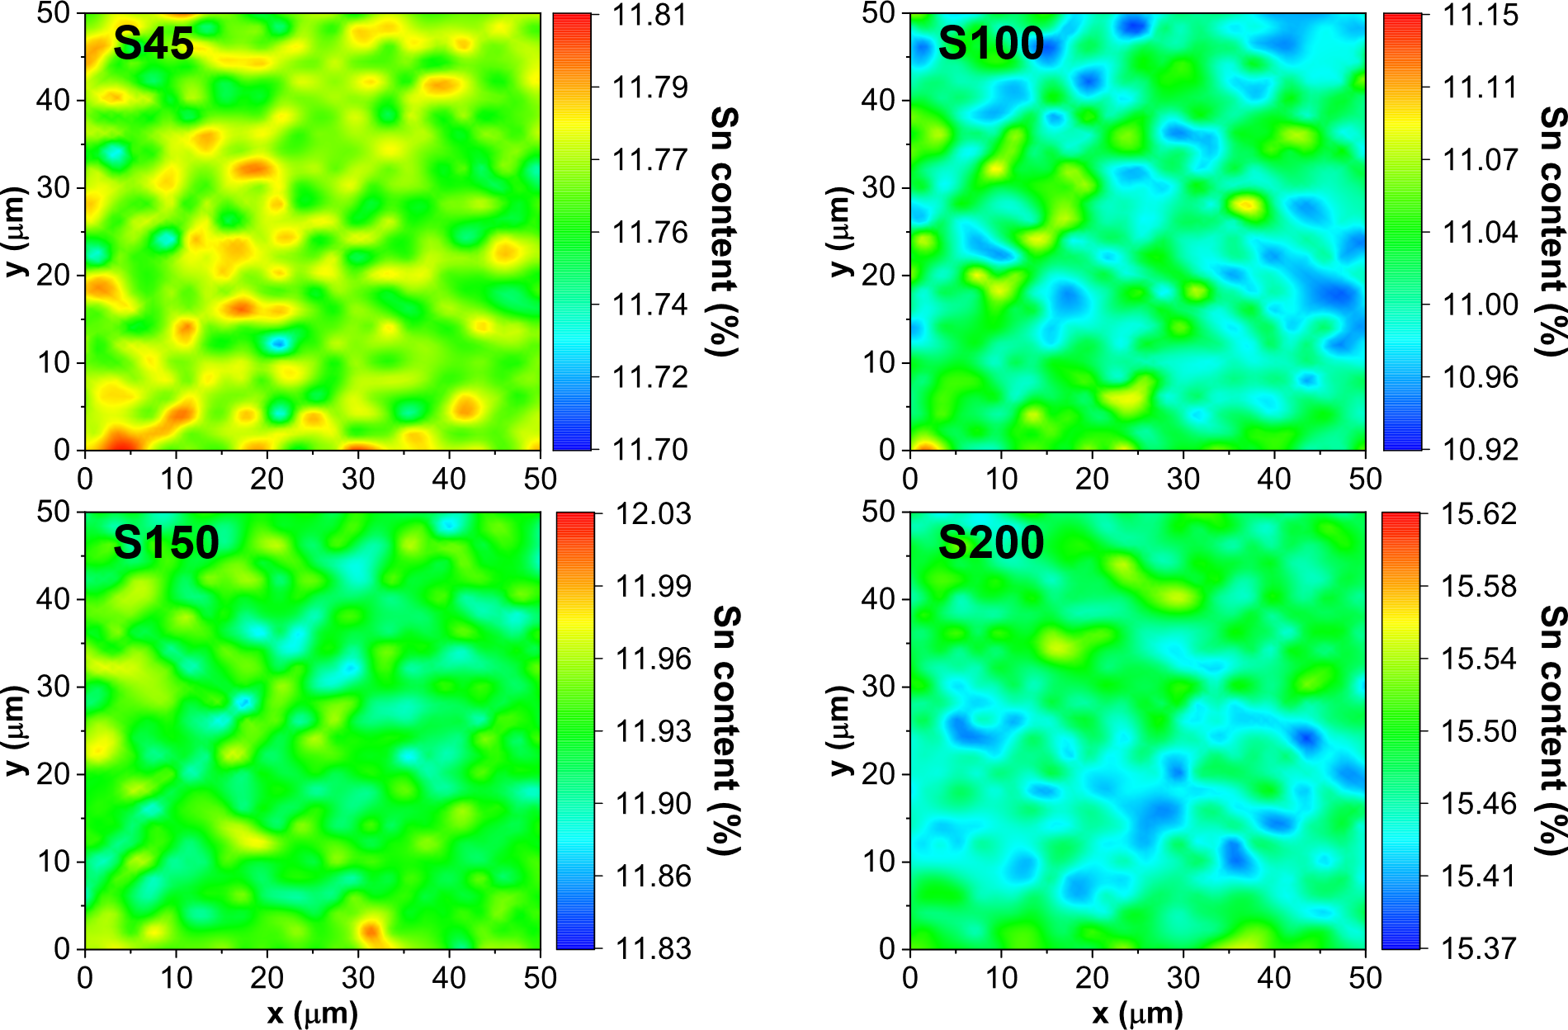
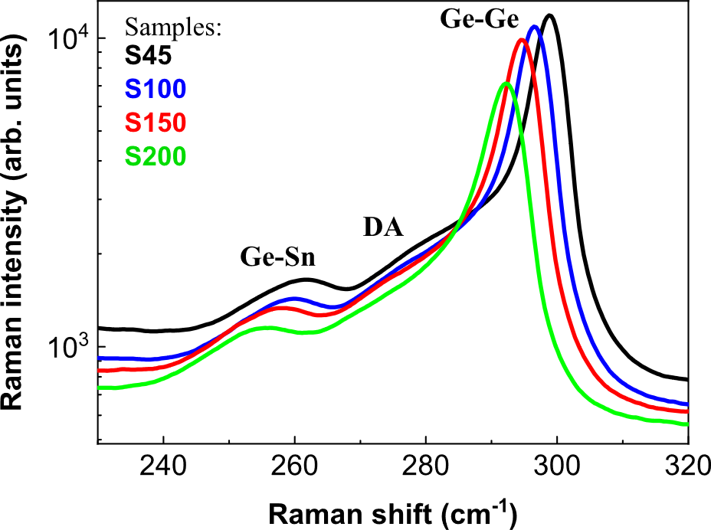
1. Experimental investigations of semiconductor structures for thermoelectrics and solar cells
Raman Spectroscopy
Photoconductivity transients

Slide 8
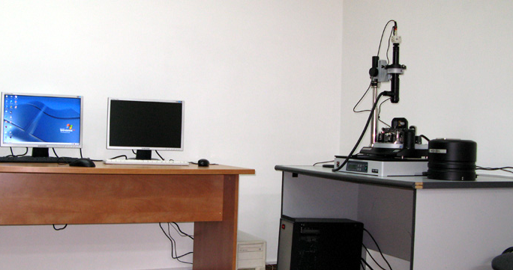
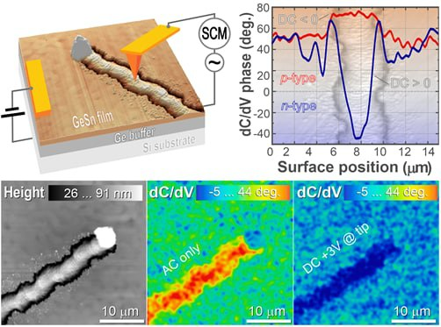
1. Experimental investigations of semiconductor structures for thermoelectrics and solar cells
AFM and Kelvin Probe Force Microscopy

Slide 9
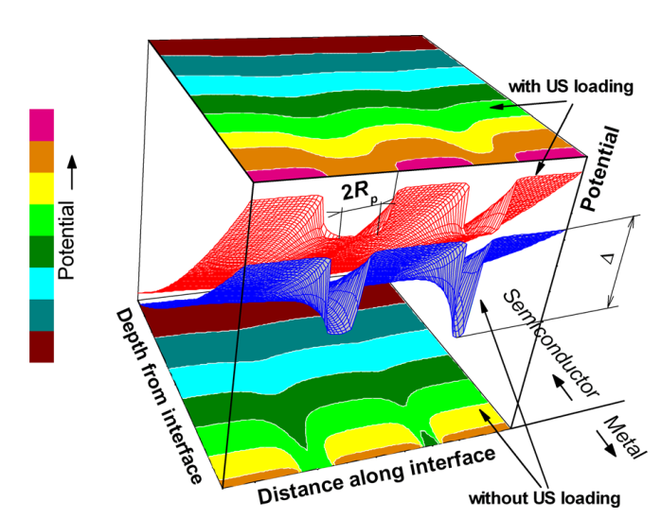
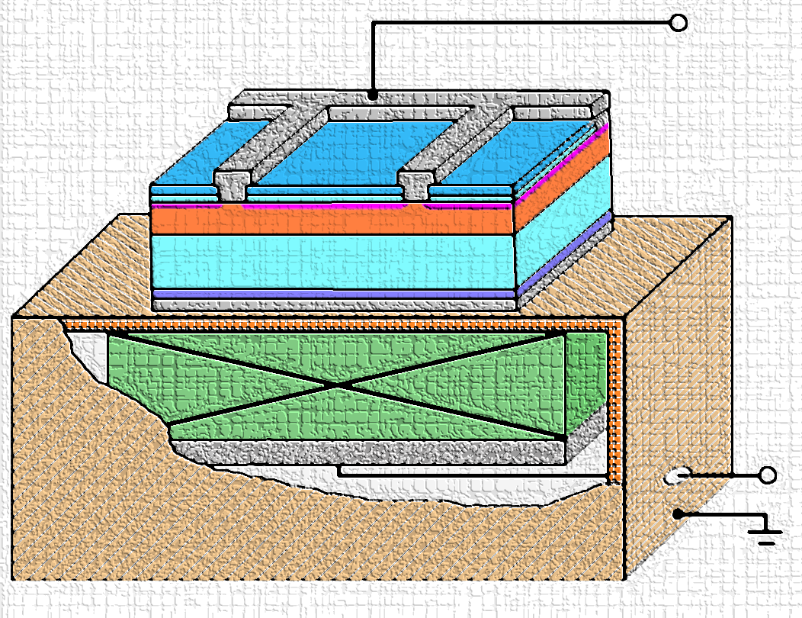
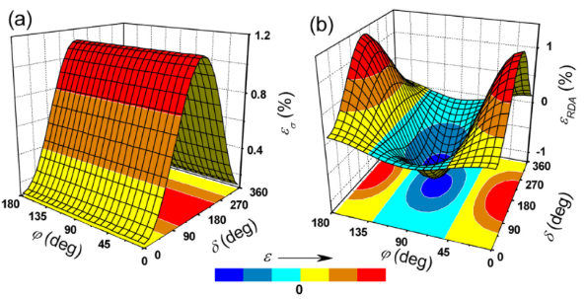
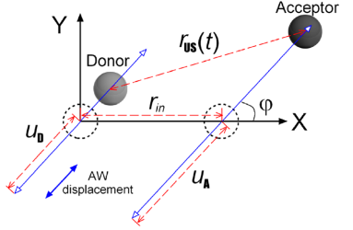
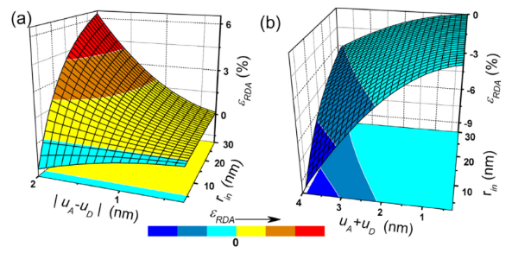

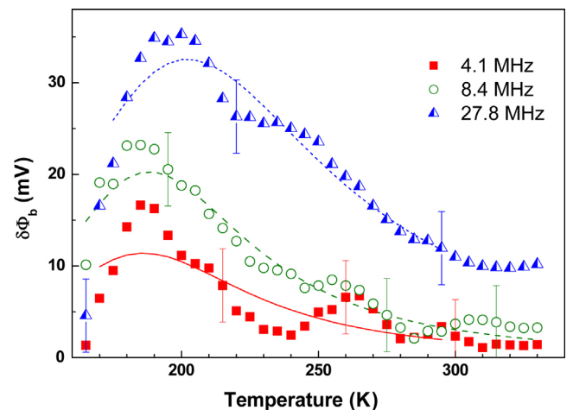
1. Experimental investigations of semiconductor structures for thermoelectrics and solar cells
Determination of semiconductor structures’ parameters under ultrasound action (100 kHz – 30 MHz, transverse and longitudinal waves)

Slide 10
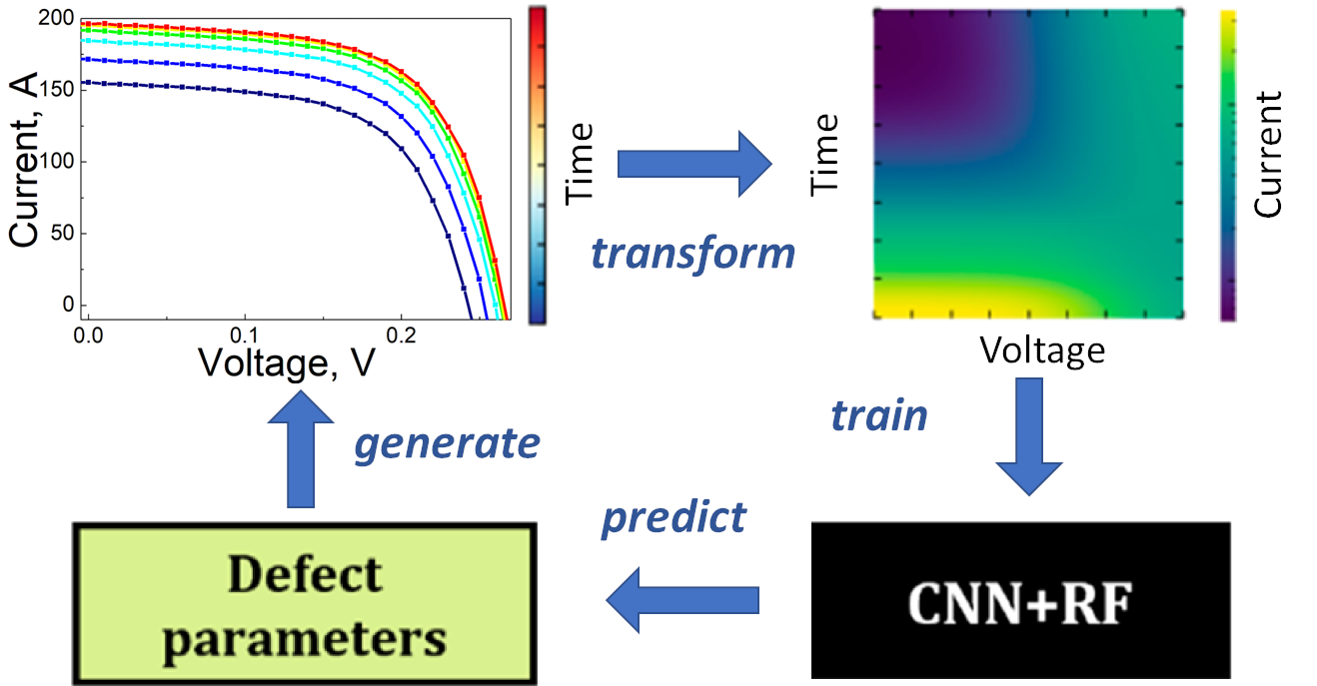
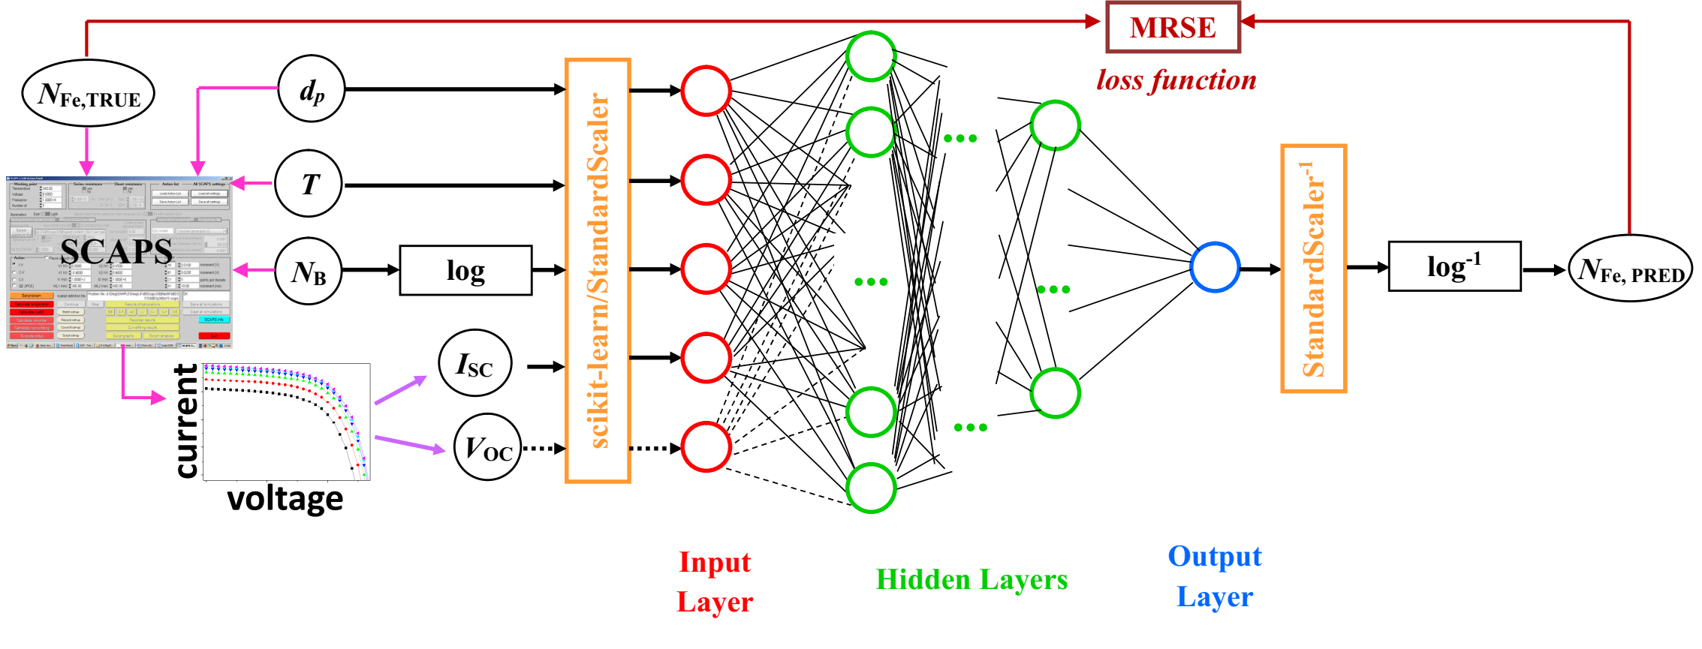
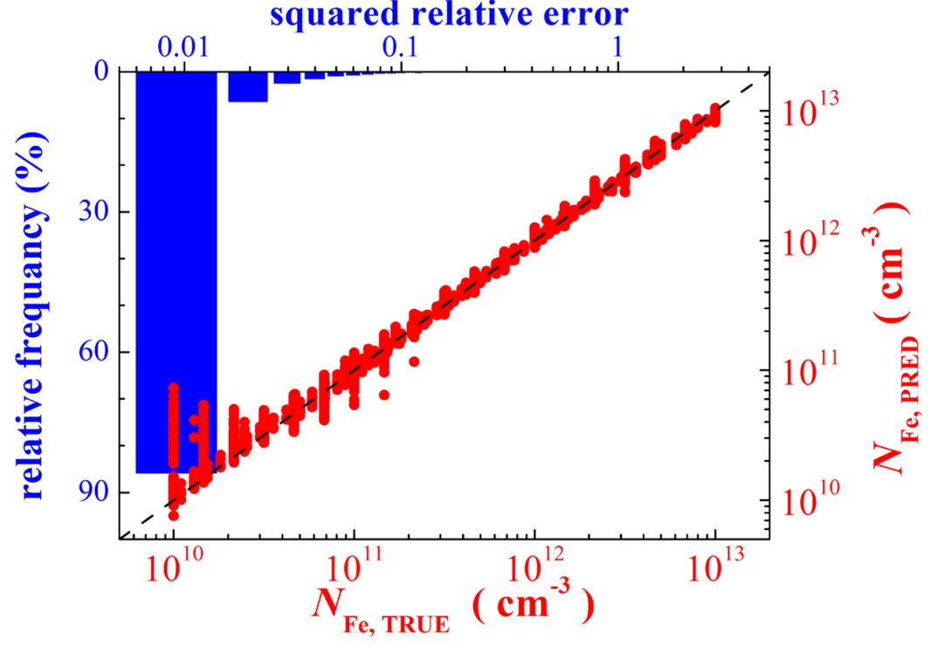
2. Using machine learning for estimation of defect contamination in solar cells
Simulation of photovoltaic structures for labeled dataset preparation
Exploring, teaching, and tunning machine learning algorithms
Testing of developed models on actual silicon solar cells

Slide 11
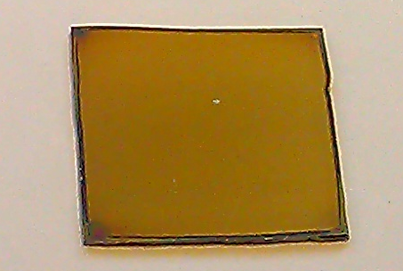
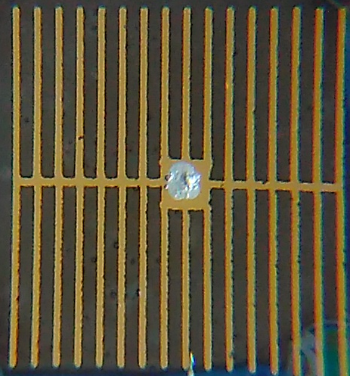
3. Sample preparation and other characterization facilities
Spin and spray coating thin film deposition
Spectral ellipsometry
Optical transmission and absorption spectroscopy
PEDOT:PSS
n-Si (001)
In/Ga eutectic back contact
PEDOT:PSS – Si photovoltaic cells

Slide 12
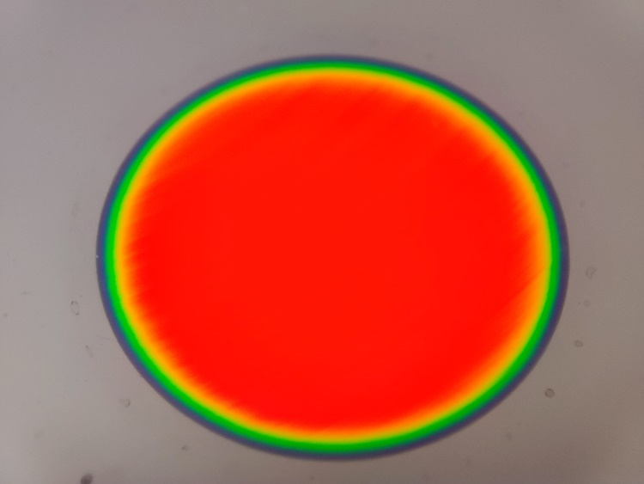
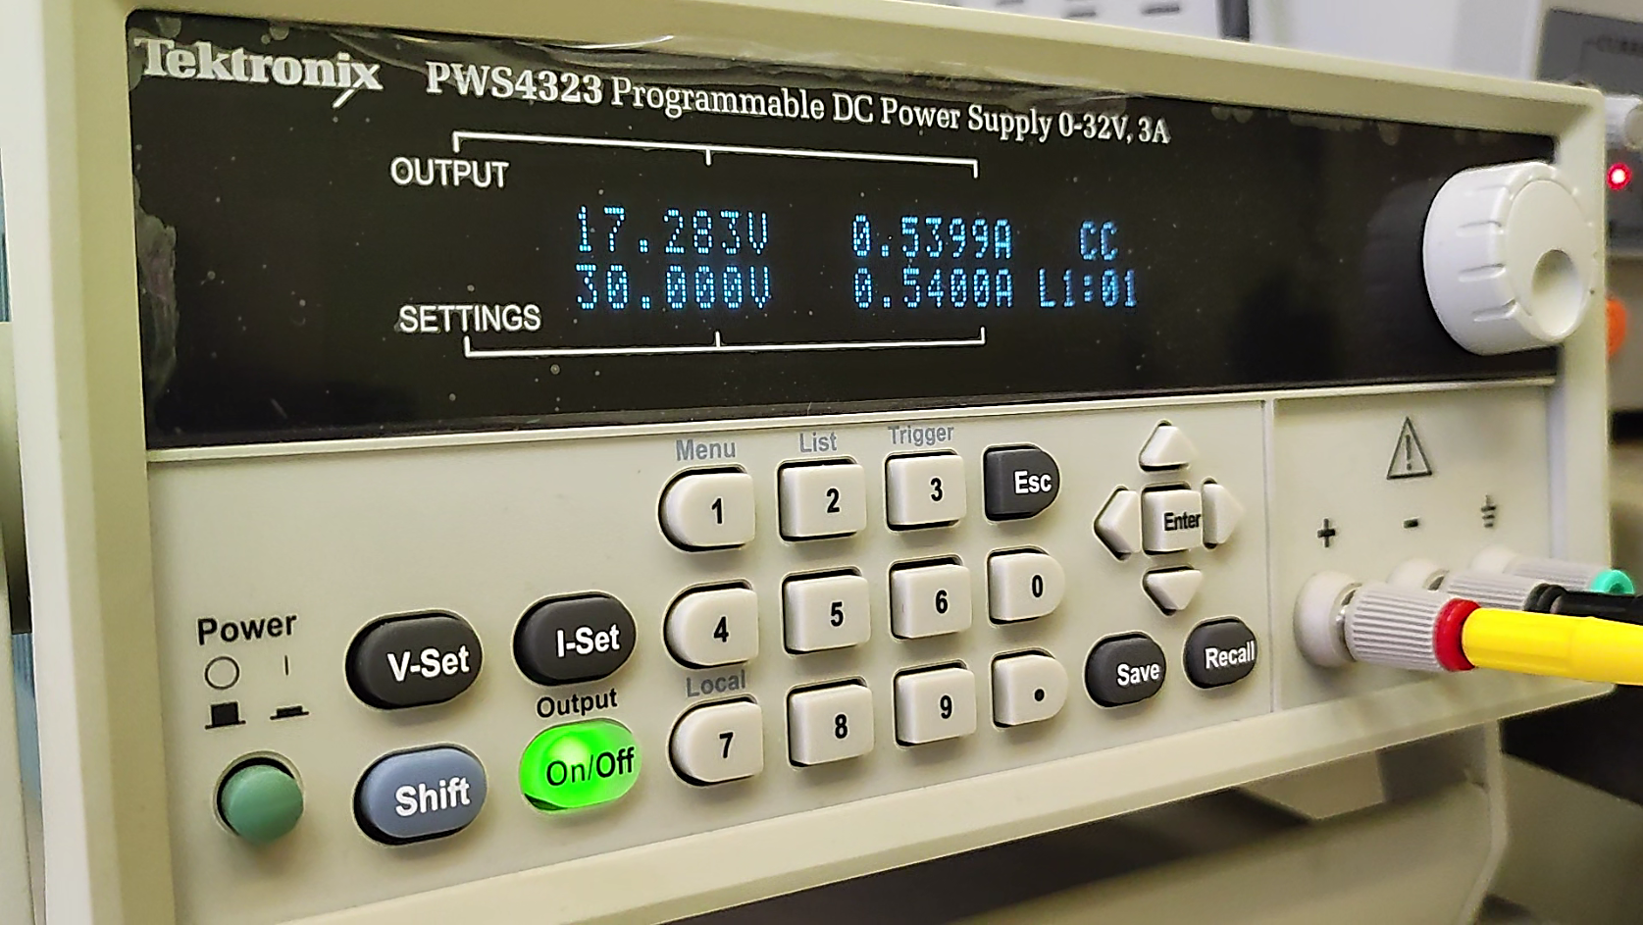
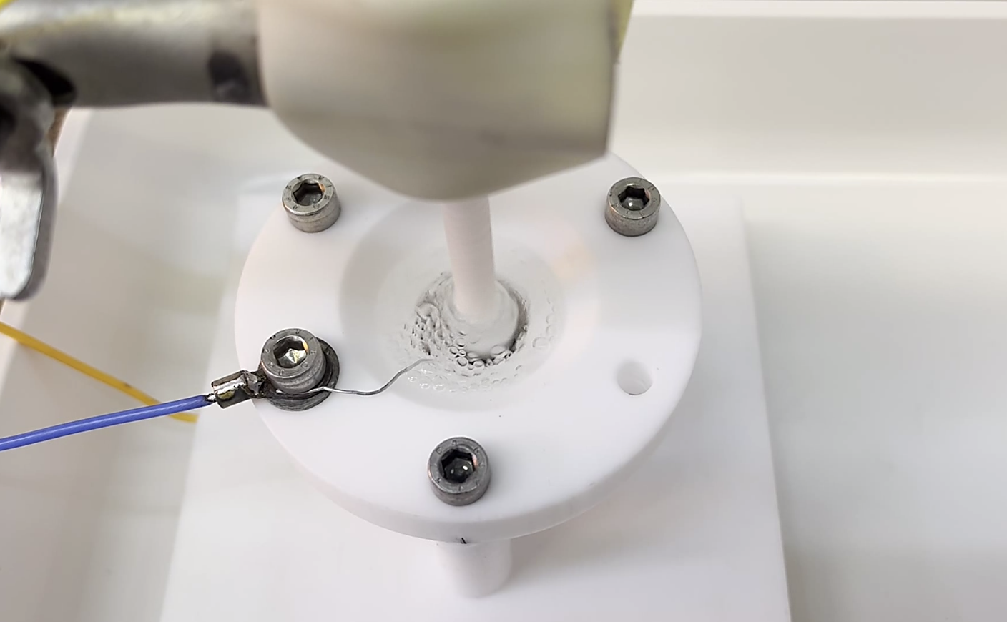
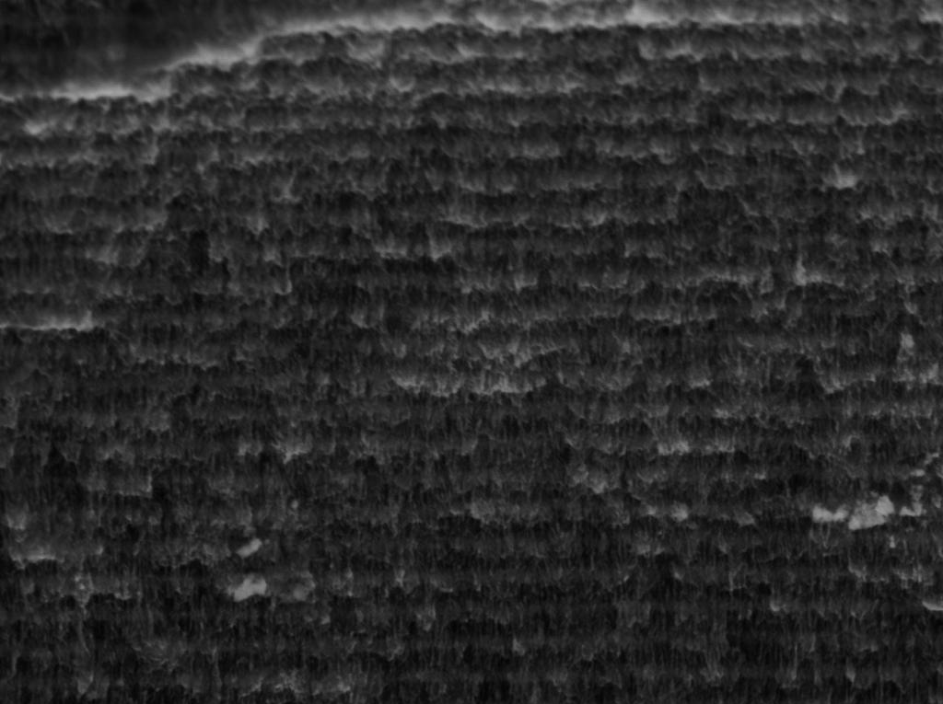
4. Synthesis of silicon multilayer porous structures and investigation of their structure, optical, and thermal properties
Electro-chemical etching of multilayer porous silicon
Gravimetry, Optical and scanning electron microscopy
Spectroscopic optical techniques

Slide 13
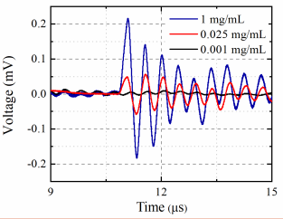
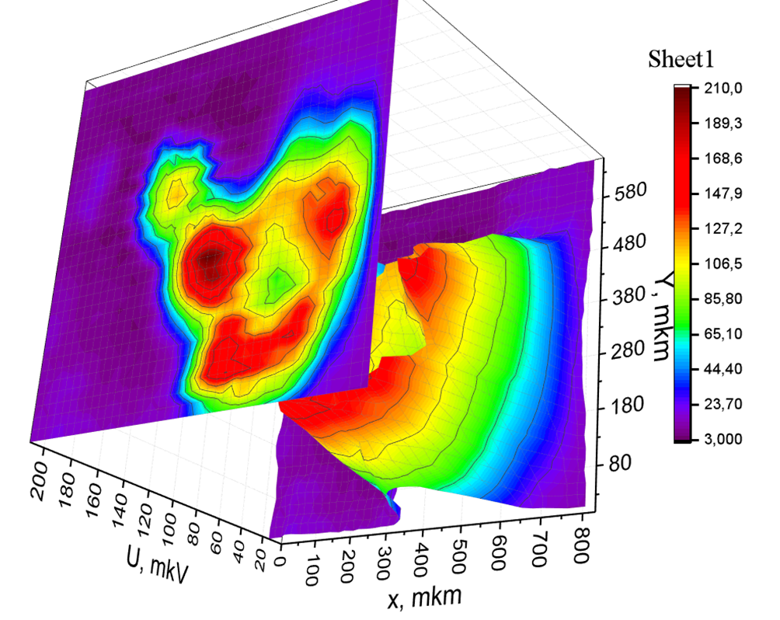
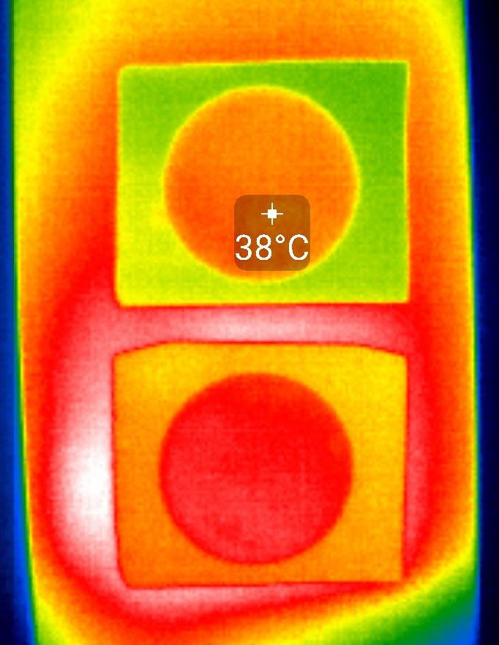
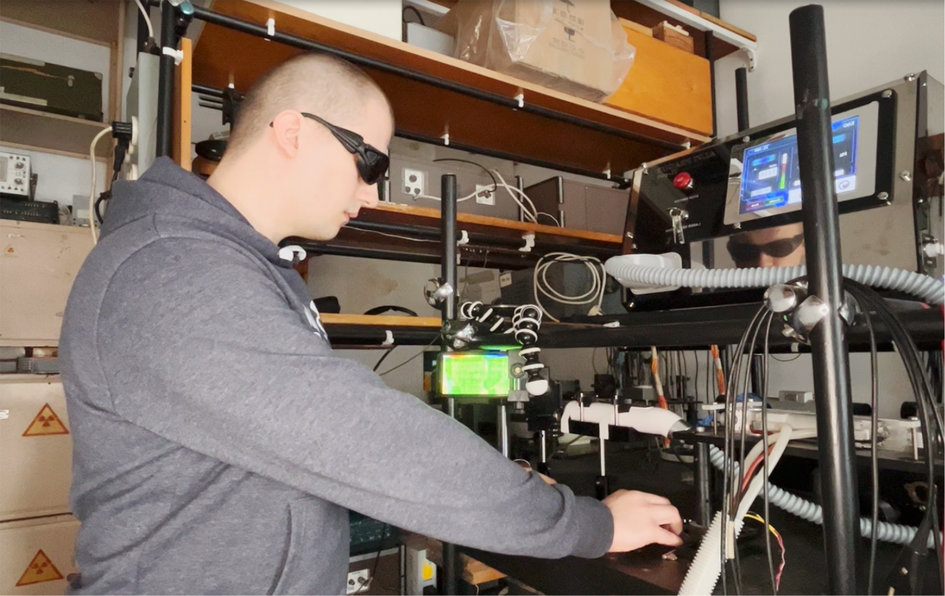
4. Synthesis of silicon multilayer porous structures and investigation of their structure, optical, and thermal properties
Photoacoustic and Photothermal techniques :
amplitude-frequency and phase-frequency responses
time and temperature dependent response of informative signal
photoacoustic and photothermal imaging
thermal diffusivity and thermal conductivity parameters

Slide 14
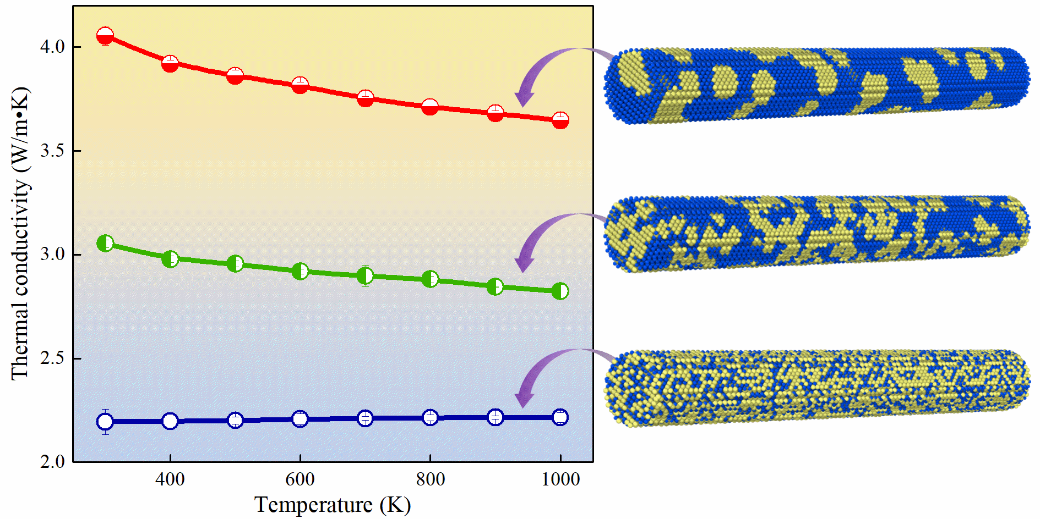





5. Modeling of phonon transport properties of nanostructures for thermal management and thermoelectric applications
Molecular dynamics simulation of thermal conductivity of semiconductor nanostructures
Anharmonic lattice dynamics
Analytical modeling of phonon transport in nanostructures
Finite element modeling of thermal phenomena in materials

Slide 15

Prof. Dr. Serhiy Kondratenko
Taras Shevchenko National University of Kyiv
Department of Optics
Kondratenko@knu.ua
Prof. Dr. Oleg Olikh
Taras Shevchenko National University of Kyiv
General Physics Department
olegolikh@knu.ua
Taras Shevchenko National University of Kyiv, 2024
64/13, Volodymyrska Street, City of Kyiv, Ukraine, 01601

